Slide 1

Memory Management
The Stack and Heap
Object Graphs
Pointers
C++ Smart Pointers
Garbage Collection
Board
Game
Point
Animal
Dog
Game
Token []
Board
Token
Human
Token
Player
Notes:
Should be mostly review. Might tie together concepts from different languages for you. We talk about these objects as if they live out there in space. But it is important to understand where they are and how they are actually connected. How they come into existence and how they go away. C++ gives us some additional options we’ll see next time

Slide 2

See Also
https://en.wikipedia.org/wiki/Memory_management
https://www.internalpointers.com/post/beginner-s-look-smart-pointers-modern-c
Notes:
Here is some additional reading for you on the web.

Slide 3

The Heap
Large area of free memory where objects come and go
Objects are “new”ed into existence (in Python “new” is implied)
Java, Python, JS – objects are always on the heap
C++ allows us to create objects on the stack
Easier lifecycle management
Loss of polymorphism
Next lesson
Java, Python, JS: garbage collection
The runtime cost of GC
C++: delete and smart pointers
Threads share the heap (can “walk” on each other)
Notes:
Python: “new” less typing but easier to miss when looking at code
Think of the “po” in polymorphism as meaning “pointer”

Slide 4
Object Graphs and the Heap
tokenX = new Token()
tokenX.letter = 'X'
tokenO = new Token()
tokenO.letter = 'O'
tkns = new Token[9]
brd = new Board()
brd.cells = tkns
p1 = new HumanPlayer()
p1.token = tokenX
p1.board = brd
p2 = new RandomPlayer()
p2.token = tokenO
p2.board = brd
gm = new Game()
gm.board = brd
gm.player1 = p1
gm.player2 = p2
gm.board.cells[3] = gm.player1.token
t = gm.board.cells[0].letter
Game
5100
Token [ ]
0300
board =
player1 =
player2 =
0100
Board
0100
9
length =
7030
cells =
0300
null
0520
8200
null
0580
null
null
HumanPlayer
7030
0520
token =
board =
0520
0520
Token
0100
'X'
letter =
RandomPlayer
8200
0580
Token
token =
board =
0580
'O'
letter =
0100

Slide 5
Python: Everything is an Object
Token [ ]
Numbers are objects
Numbers are immutable
No “character” type
dir(9)
(9).__add__(4)
0300
int
0220
length =
0220
9
null
0580
null
0520
0520
str
Token
0820
0820
'X'
letter =
0580
str
Token
2600
2600
'O'
letter =
Notes:
In the number object, storage can grow to make room for bigger numbers
Operator overloading: __add__ is “+”. Strings and numbers implement this, which is why you can add two strings with “+”. You can overload in your own classes. Operator overloading – part of python.

Slide 6
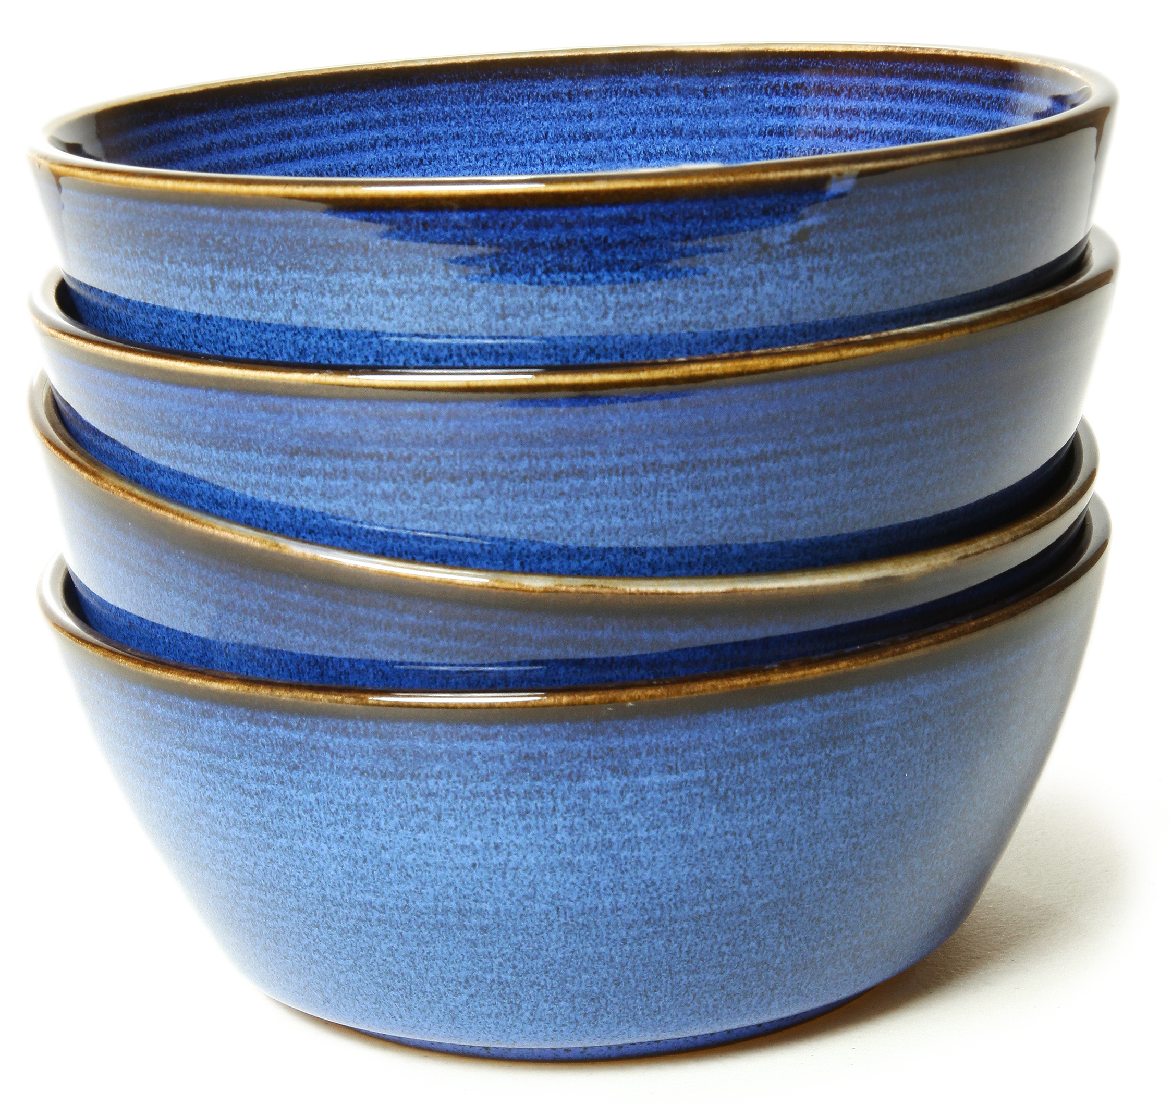
The Stack
Where the “call/return” information is kept
Last in first out (picture a stack of plates)
Local variables also go here
Every thread has its own stack (not shared)
C++ allows creating objects on the stack
Notes:
C++ objects on stack … next lesson

Slide 7
The Stack
void print(string p) {
cout << p << endl;
return;
}
void getMove() {
print("What is your move?");
print("Are you sure?");
return;
}
void playHuman() {
print("Ready, human!");
getMove();
print("Good move!");
return;
}
int main(int argc, char ** argv) {
playHuman();
return 0;
}
150
170
200
250
280
500
580
600
610
640
40
50
C++
1000
4500
1004
50
1008
600

Slide 8
The Stack
void print(string p) {
cout << p << endl;
return;
}
void getMove() {
print("What is your move?");
print("Are you sure?");
return;
}
void playHuman() {
print("Ready, human!");
getMove();
print("Good move!");
return;
}
int main(int argc, char ** argv) {
playHuman();
return 0;
}
150
170
200
250
280
500
580
600
610
640
40
50
C++
1000
4500
1004
50
1008
610
1012
250
Notes:
Computer is dumb … just follows the sequences and goes to the addresses

Slide 9
The Stack
void print(string p) {
cout << p << endl;
return;
}
void getMove() {
print("What is your move?");
print("Are you sure?");
return;
}
void playHuman() {
print("Ready, human!");
getMove();
print("Good move!");
return;
}
int main(int argc, char ** argv) {
playHuman();
return 0;
}
150
170
200
250
280
500
580
600
610
640
40
50
C++
1000
4500
1004
50
1008
610
1012
280

Slide 10
The Stack
void print(string p) {
cout << p << endl;
return;
}
void getMove() {
print("What is your move?");
print("Are you sure?");
return;
}
void playHuman() {
print("Ready, human!");
getMove();
print("Good move!");
return;
}
int main(int argc, char ** argv) {
playHuman();
return 0;
}
150
170
200
250
280
500
580
600
610
640
40
50
C++
1000
4500
1004
50
1008
640

Slide 11


Stack and Heap
C++
class Point {
public:
int x, y, z;
};
void pointDouble(Point * p) {
int b = p->x * 2;
p->x = b;
p = new Point();
p->x = 10;
}
void main() {
int b = 3;
Point * a = new Point();
int c = 4;
a->x = b;
a->y = c;
b = 8;
pointDouble(a);
cout << b << endl;
cout << a->x << endl;
}
class Point {
public int x,y,z;
}
void pointDouble(Point p) {
int b = p.x * 2;
p.x = b;
p = new Point();
p.x = 10;
}
void main() {
int b = 3;
Point a = new Point();
int c = 4;
a.x = b;
a.y = c;
b = 8;
pointDouble(a);
System.out.println(b);
System.out.println(a.x);
}
Java
class Point:
pass
def pointDouble(p):
b = p.x * 2
p.x = b
p = Point()
p.x = 10
b = 3
a = Point()
c = 4
a.x = b
a.y = c
b = 8
pointDouble(a)
print(b)
print(a.x)
Python
???
???

Slide 12
Stack and Heap
class Point {
public int x,y,z;
}
void pointDouble(Point p) {
int b = p.x * 2;
p.x = b;
}
void main() {
int b = 3;
Point a = new Point();
int c = 4;
a.x = b;
a.y = c;
b = 8;
pointDouble(a);
System.out.println(b);
System.out.println(a.x);
}
Java
Stack
Heap
return
4500
Point
0300
3
b
8
x =
3
0
y =
4
a
0300
0
z =
0
c
4
return
8260
p
0300
b
6
8260

Slide 13
Stack and Heap
class Point {
public int x,y,z;
}
void pointDouble(Point p) {
int b = p.x * 2;
p.x = b;
p = new Point();
p.x = 10;
}
void main() {
int b = 3;
Point a = new Point();
int c = 4;
a.x = b;
a.y = c;
b = 8;
pointDouble(a);
System.out.println(b);
System.out.println(a.x);
}
Java
Stack
Heap
return
4500
Point
0300
b
8
x =
6
a
0300
y =
4
z =
0
c
4
return
8260
Point
0520
p
0520
x =
0300
10
0
y =
0
b
6
z =
0
C++
void pointDouble(Point * p) {
int b = p->x * 2;
p->x = b;
p = new Point();
p->x = 10;
}
Garbage Collection
8260

Slide 14
Stack and Heap
class Point {
public int x,y,z;
}
void pointDouble(Point p) {
int b = p.x * 2;
p.x = b;
p = new Point();
p.x = 10;
}
void main() {
int b = 3;
Point a = new Point();
int c = 4;
a.x = b;
a.y = c;
b = 8;
pointDouble(a);
System.out.println(b);
System.out.println(a.x);
}
Java
Stack
Heap
return
4500
Point
0300
b
8
x =
0
6
a
0300
y =
4
z =
0
c
4
Point
0520
x =
0
10
8
6
y =
0
z =
0
Garbage Collection

Slide 15
delete in C++
C++
Point * p = new Point();
// ...
delete p;
Stack
Heap
p
0300
Point
0300
x =
?
y =
?
z =
?
Happy Path
Object is created
Object is used
Object is deleted to free memory

Slide 16
delete in C++
C++
Point * p = new Point();
// ...
p = new Point();
// or p = NULL;
Stack
Heap
p
0300
0600
Point
0300
x =
?
y =
?
Leak
z =
?
Point
Memory Leak
Memory is never freed
Might build up slowly over time and eventually kill the program
0600
x =
?
y =
?
z =
?

Slide 17
delete in C++
C++
Point * p = new Point();
// ...
if (monday) {
delete p;
}
Stack
Heap
p
0300
Point
0300
x =
?
y =
?
z =
?
Memory Leak
Not always obvious
Complex control flow
Exceptions

Slide 18
delete in C++
C++
Point * p = new Point();
Point * k = p;
// ...
delete k;
cout << p->x << endl;
Stack
Heap
p
0300
Point
0300
k
0300
x =
0
y =
1
z =
2
Premature Delete
Might be OK for a while
Unpredictable failure
Like others: difficult to find

Slide 19

Smart Pointers in C++
class Player {
public:
Player * companion;
};
void makePlayers() {
Player * jasmine = new Player();
}
C++
class Player {
public:
std::shared_ptr<Player> companion;
};
void makePlayers() {
std::shared_ptr<Player> jasmine = std::make_shared<Player>();
}
C++
void makePlayers() {
std::shared_ptr<Player> jasmine = std::make_shared<Player>();
std::shared_ptr<Player> albert = std::make_shared<Player>();
jasmine->companion = albert;
albert->companion = jasmine;
}
C++
Circular Reference
https://www.internalpointers.com/post/beginner-s-look-smart-pointers-modern-c

Slide 20
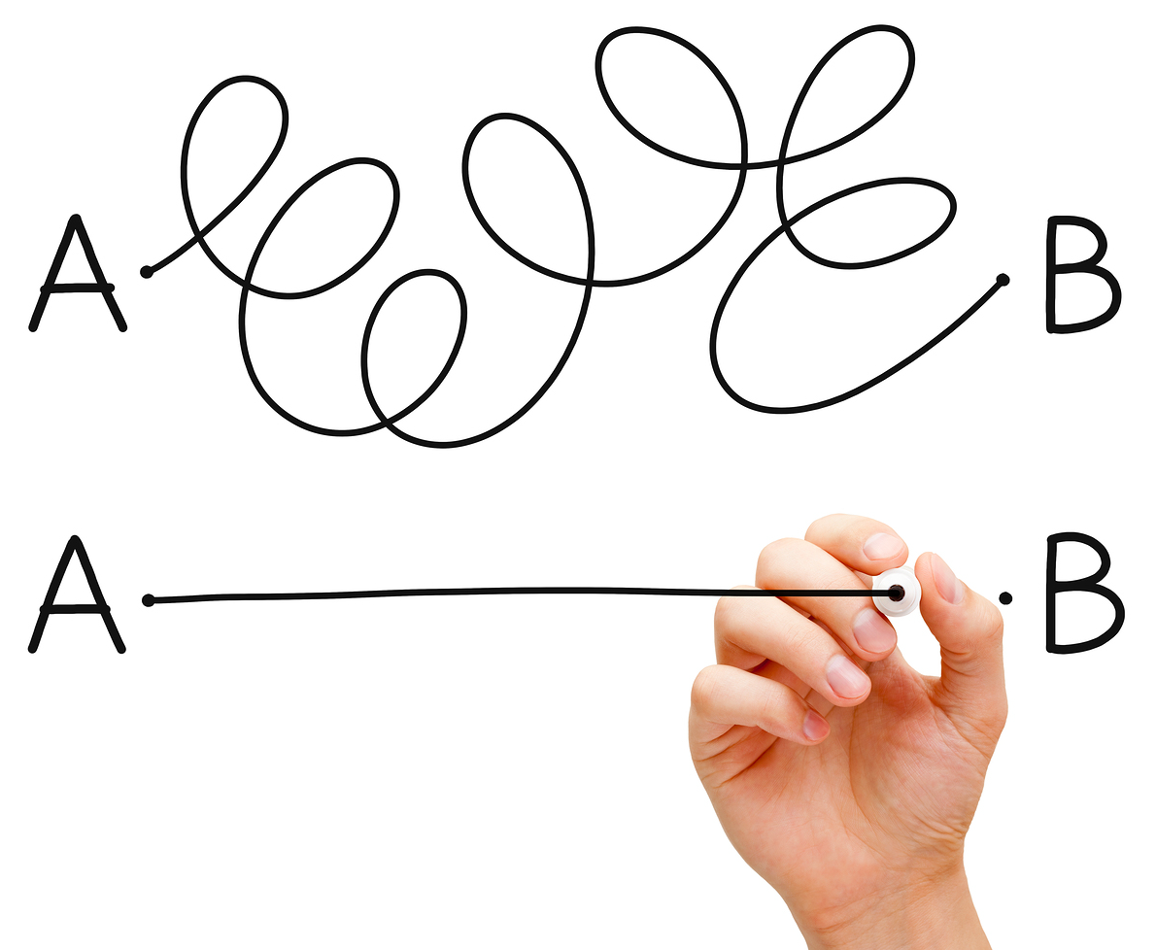
Tinkering
Create the Point class in Python
Give it a constructor and appropriate getters/setters
Give it an “__add__” method that returns a new Point – the sum of the two points
Create a Line class in Python (a line has two Points)
Notes:
Here are a couple of things to think about and/or try. This is totally optional … nothing for you to send to me.

